Slide 1
Chapter 6: Wireless Network Experiments using NS2
This lecture is partially based on notes from Sung Park, Network and Embedded Systems Lab (NESL), Electrical Engineering, UCLA

Slide 2
Outline
2
Overview of wireless simulation in ns-2
Example to run a simulation-Scenario
SensorViz: GUI based Scenario Generation Tool
Wireless network experiments
Homework

Slide 3
Overview of wireless simulation in ns-2
CMU’s Monarch group’s mobility extension to ns
Various modules were added to ns-2 to simulate node mobility and wireless networking
The wireless model essentially consists of
MobileNode at the core
additional supporting features
Ad-hoc Routing(DSR, DSDV, TORA, AODV)
MAC802.11
Radio Propagation Model
Channel
3
Notes:
monarch /ˈmɒnək/
3

Slide 4
Main components of a mobile node in ns2 used for DSDV routing
DSDV: Destination-Sequenced Distance-Vector Routing
(目的节点序列距离矢量协议)
4
Notes:
4

Slide 5
Main components of a mobile node used for DSR routing
DSR: Dynamic Source Routing protocol (动态源路由协议)
5
Notes:
5

Slide 6
Mobile Node Modules
Agent
Responsible for packet generations and receptions
Can think of it as an Application layer
E.g.:CBR(Constant Bit Rate), TCP, Sink, FTP, etc.
RTagent(DSDV, TORA, AODV, DSR)
Ad-hoc network routing protocols
Configure multi hop routes for packets
LL (Link Layer)
Runs data link protocols
Fragment and reassemble packets
Runs address resolution protocol(ARP) to resolve (IP address to MAC address) conversions
6

Slide 7
Mobile Node Modules (Continued)
7
IFq (Interface Queue)
PriQueue is implemented to give priority to routing protocol packets
Supports filter to remove packets destined to specific address
Mac Layer
IEEE 802.11 protocol is implemented
Uses RTS/CTS/DATA/ACK pattern for unicast and simply sends out DATA for broadcast

Slide 8
Mobile Node Modules (Continued)
NetIF (Network Interfaces)
Hardware interface used by mobile node to access the channel
Simulates signal integrity, collision, tx error
Mark each transmitted packet with transmission power, wavelength etc.
Radio Propagation Model
Uses Fress-space attenuation(1/r^2) at near distance and Two ray ground (1/r^4) at far distance
Decides whether the packet can be received by the mobile node with given distance, transmit power and wavelength
Implements Omni Directional Antenna module which has unity gain for all direction
Channel
Simulates the shared medium
Supports the medium access mechanisms of the MAC objects on the sending side
8
Notes:
omni- /ˈɒmnɪ/
8

Slide 9
Outline
9
Overview of wireless simulation in ns-2
Example to run a simulation-Scenario
SensorViz: GUI based Scenario Generation Tool
Wireless network experiments
Homework

Slide 10
Running a simulation-Scenario
500m
TCP
TCP
TCP
TCPsink
TCPsink
TCPsink
500m
node_(0)
node_(0)
node_(0)
node_(1)
node_(1)
node_(1)
10

Slide 11
Setting Up Variables
#======================================================================
# Define options
#======================================================================
set val(chan) Channel/WirelessChannel ;# channel type
set val(prop) Propagation/TwoRayGround ;# radio-propagation model
set val(ant) Antenna/OmniAntenna ;# Antenna type
set val(ll) LL ;# Link layer type
set val(ifq) Queue/DropTail/PriQueue ;# Interface queue type
set val(ifqlen) 50 ;# max packet in ifq
set val(netif) Phy/WirelessPhy ;# network interface type
set val(mac) Mac/802_11 ;# MAC type
set val(rp) DSDV ;# ad-hoc routing protocol
set val(nn) 2 ;# number of mobilenodes
11

Slide 12
Setting Up Variables
Instantiate simulator object
set ns_ [new Simulator]
Setup Trace File
set tracefd [open simple.tr w]
$ns_ trace-all $tracefd
Create Topography: define the area under which the simulation occurs
set topo [new Topography]
$topo load_flatgrid 500 500
Create Object GOD
create-god $val(nn)
/*God (general operations director): store global information about the state
of the environment, network or nodes that an omniscient observer would
have.
In simple words, we need to define the GOD to manage the details of
operations we supply such as the movement patterns in our simulations.*/
12
Notes:
Define the General Operations Director (“GOD”).
Quoted from CMU document, "GOD (General Operations Director) is the object that is used to store global information about the state of the environment, network or nodes that an omniscient observer would have, but that should not be made known to any participant in the simulation." In simple words, we need to define the GOD to manage the details of operations we supply such as the movement patterns in our simulations.
omniscient /ɒmˈnɪsiənt/
12

Slide 13
Configuring Mobilenode
# Configure nodes
$ns_ node-config -adhocRouting $val(rp) \
-llType $val(ll) \
-macType $val(mac) \
-ifqType $val(ifq) \
-ifqLen $val(ifqlen) \
-antType $val(ant) \
-propType $val(prop) \
-phyType $val(netif) \
-topoInstance $topo \
-channelType $val(chan) \
-agentTrace ON \
-routerTrace ON \
-macTrace OFF \
-movementTrace OFF
for {set i 0} {$i < $val(nn) } {incr i} {
set node_($i) [$ns_ node ] ;# create nodes
$node_($i) random-motion 0 ;# disable random motion
}
13

Slide 14
Configuring Movement
Configure Initial Position
$node_(0) set X_ 5.0
$node_(0) set Y_ 2.0
$node_(0) set Z_ 0.0
$node_(1) set X_ 390.0
$node_(1) set Y_ 385.0
$node_(1) set Z_ 0.0
Create Movement: $ns at $time $node setdest <x2> <y2> <speed>
At $time second, the node would start moving from its initial position towards (x2, y2) at a speed of <speed> m/s.
# Node_(1) starts to move towards node_(0)
$ns_ at 50.0 "$node_(1) setdest 25.0 20.0 15.0"
$ns_ at 10.0 "$node_(0) setdest 20.0 18.0 1.0"
# Node_(1) then starts to move away from node_(0)
$ns_ at 100.0 "$node_(1) setdest 490.0 480.0 15.0"
14
Notes:
Towards, En [tə'wɔːdz]

Slide 15
Setup traffic flow
set tcp [new Agent/TCP]
$tcp set class_ 2 ;# associate tcp traffic to flow 2
set sink [new Agent/TCPSink]
$ns_ attach-agent $node_(0) $tcp
$ns_ attach-agent $node_(1) $sink
$ns_ connect $tcp $sink
set ftp [new Application/FTP]
$ftp attach-agent $tcp
$ns_ at 10.0 "$ftp start”
FTP
TCP
Sink
node_(0)
node_(1)
15
Notes:
'set class_' allows to differentiate multiple flows.
Associating a different class to different flows and then, a single color to each class is useful to easily follow the different flows in nam.
Assume that at the beginning of the tcl file, there is:
$ns color 1 Blue
$ns color 2 Red
This defines the color 'blue' for the 'class_ 1' flows and the color 'red' for the 'class_ 2' flows.
15

Slide 16
Set Stop Time and Start Simulation
Set Simulation Stop Time
# Tell nodes when the simulation ends
for {set i 0} {$i < $val(nn) } {incr i} {
$ns_ at 150.0 "$node_($i) reset";
}
$ns_ at 150.0 "stop"
$ns_ at 150.01 "puts \"NS EXITING...\" ; $ns_ halt"
proc stop {} {
global ns_ tracefd
$ns_ flush-trace
close $tracefd
}
Finally, Start The Simulation
puts "Starting Simulation..."
$ns_ run
16

Slide 17
Running the Script
Run the example
>> cd <nsroot>\ns-allinone-2.28\ns2.28\ns-tutorial\examples\
>>ns simple-wireless.tcl
Generate trace file
The simulation will generate a trace file named “simple.tr”
Homework:
Please revise simple-wireless.tcl so that the tcl script file will run .nam file after simulation
17

Slide 18
Trace File
18
r 100.381997477 _1_ AGT --- 82 tcp 1060 [13a 1 0 800] ------- [0:0 1:0 32 1] [32 0] 1 0
r:receive event, 100.381997477:time stamps,
_1_:node 1, AGT:trace generated by agent, 82:event(pkt) id, tcp: tcp packet,
1060:packet size,
13a(hex):time to send packet
1: receiver mac id, 0:transmitter mac id,
800:pkt type(800/806 for IP/ARP), 0:0: sender address:port#
1:0: receiver address:port#, 32: TTL
1:next hop address, [32 0]: TCP sequence #, ack #
1:#of times pkt was forwarded 0:optimal number of forwards

Slide 19
Outline
19
Overview of wireless simulation in ns-2
Example to run a simulation-Scenario
SensorViz:GUI based Scenario Generation Tool
Wireless network experiments
Homework
Notes:
graphical user interface (GUI)
19

Slide 20
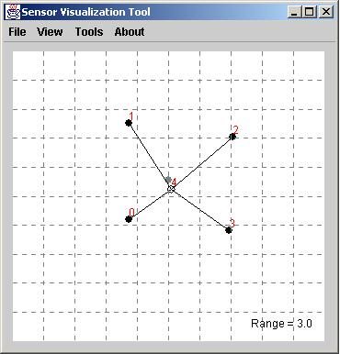
SensorViz:GUI based Scenario Generation Tool
http://nesl.ee.ucla.edu/projects/sensorsim/
20

Slide 21
Using SensorViz output
SensorViz output may look like the following
# number of nodes = 2
# dimension x = 20000
# dimension y = 20000
# transmission range = 3000.0
# beacon = 4
$node_(0) set X_ 12415.458937198067
$node_(0) set Y_ 11612.90322580645
$node_(0) set Z_ 0.0
$node_(1) set X_ 7874.396135265701
$node_(1) set Y_ 8585.607940446649
$node_(1) set Z_ 0.0
Simply include the file by using “Source” command in your main tcl script
source “filename”
21
Notes:
Import/export

Slide 22
Outline
22
Overview of wireless simulation in ns-2
Example to run a simulation-Scenario
SensorViz:GUI based Scenario Generation Tool
Wireless network experiments
Homework

Slide 23
Experiment 1: Setting transmission range
Three propagation models in ns
the free space model
the two-ray ground reflection model
the shadowing model
Functions of propagation models at PHY module
Predict the received signal power of each packet
Determine whether one frame is received correctly by the receiver, according to a predefined threshold
Pr ∈(-∞, CSThresh_): the frame is discarded immediately
Pr ∈[CSThresh_, RxThresh_): the frame is tagged as corrupted and sent to MAC
Pr ∈[RxThresh_, + ∞): frame is succ. received and sent to MAC
Pr: the received signal power; RXThresh_: the reception threshold; CSThresh_: the carrier sensing threshold;
RXThresh_ and CSThresh_ are calculated by a same formula
23

Slide 24

Two-ray ground reflection model
The two-ray ground reflection model considers both the direct path and a ground reflection path.
This model gives more accurate prediction at a long distance than the free space model.
The received power at distance d, Pr, is predicted by
Pt: the transmitted signal power
Gt: the antenna gains of the transmitter (Gt =1 is often chosen)
Gr: the antenna gains of the receiver (Gr=1 is often chosen)
L: the system loss (L =1 is often chosen)
ht: the height of the transmit antenna
hr: the height of the receive antenna
24

Slide 25
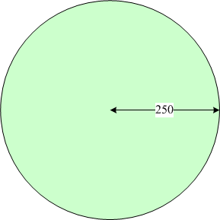
Setting transmission range in TCL scripts
Assume that the frame can be successfully received when the distance between sender and receiver ≤ 250
Formula for two-ray ground model
(0.28183815*1.5^2*1.5^2)/(250^4) = 3.652e-10
Set transmssion range in TCL scripts
set val(prop) Propagation/TwoRayGround ;# radio-propagation model
Antenna/OmniAntenna set X_ 0
Antenna/OmniAntenna set Y_ 0
Antenna/OmniAntenna set Z_ 1.5 ; #antenna height
Antenna/OmniAntenna set Gt_ 1.0 ; #antenna gains
Antenna/OmniAntenna set Gr_ 1.0 ; #antenna gains
Phy/WirelessPhy set RXThresh_ 3.652e-10 ; #the reception threshold
Phy/WirelessPhy set Pt_ 0.28183815 ; # the transmitted signal power
Phy/WirelessPhy set freq_ 914e+6 ; #make it work like the 914MHz Lucent WaveLAN DSSS radio interface
Phy/WirelessPhy set L_ 1.0 ; # the system loss
25

Slide 26
Run the example on the transmission range
26
Understand test_radius.tcl, wradius.awk
Run the example
>> cd <home>\ wmn_class_exp\wmn_lab_exp\11b_hide_expose
%set $node_(1) set X_ 280.0 in test_radius.tcl
>> ns test_radius.tcl
%set $node_(1) set X_ 281.0 in test_radius.tcl
>> ns test_radius.tcl
What’s your conclusoin?
Notes:
Conclusion: node 1 can no longer receive node 0’s packet when you ‘set $node_(1) set X_ 281.0’.

Slide 27
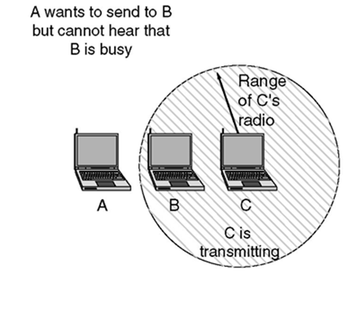
Experiment 2: Hidden terminal problem
27

Slide 28
Run the example on hidden terminal problem
Understand test_hidden_terminal.tcl, whid1.awk, whid2.awk
Run the example
>> cd <home>\wmn_class_exp\wmn_lab_exp\11b_hide_expose
%set Mac/802_11 set RTSThreshold_ 0 in test_hidden_terminal.tcl
>> ns test_hidden_terminal.tcl
%set Mac/802_11 set RTSThreshold_ 3000 in test_hidden_terminal.tcl
>> ns test_hidden_terminal.tcl
What’s your conclusoin?
28
Notes:
Conclusion: RTS/CTS can help solve the hidden terminal problem.

Slide 29
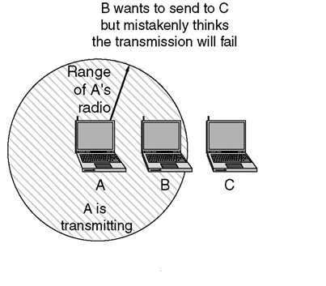
Experiment 3: exposed terminal problem
29

Slide 30
Run the example on exposed terminal problem
Understand test_exposed_terminal.tcl, wexp1.awk, wexp2.awk
Run the example
>> cd <home>\wmn_class_exp\wmn_lab_exp\11b_hide_expose
%set Mac/802_11 set RTSThreshold_ 0 in test_exposed_terminal.tcl
>> ns test_exposed_terminal.tcl
%set Mac/802_11 set RTSThreshold_ 3000 in test_exposed_terminal.tcl
>> ns test_exposed_terminal.tcl
What’s your conclusoin?
30
Notes:
Conclusion: RTS/CTS cannot help solve the exposed terminal problem.

Slide 31
Outline
31
Overview of wireless simulation in ns-2
Example to run a simulation-Scenario
SensorViz:GUI based Scenario Generation Tool
Wireless network experiments
Homework

Slide 32
Homework: validation of Bianchi model
Consider a star WLAN with 1 AP and n nodes
n nodes always have packets (destined to AP) to transmit
AP only acts as a receiver
Assume ideal channel conditions
Assume that all nodes and the AP can hear each other.
Target: validate Bianchi model
Collision probability
Throughput
Total delay
3
2
4
1
AP
n-2
n
n-1
32

Slide 33
Bianchi model: theoretical analysis
Question 1: Calculate the performance metrics theoretically from the Bianchi model[Bianchi00]
Collision probability
In the Bianchi model, the collision probability p is a critical parameter, which determines all other performance metrics such as throughput and delay. The collision probability p is governed by a fixed-point equation as follows [see Eqs. (7) and (9) in [Bianchi00] ].
Assume Wmin = 32, m = 5, and the node number n=2:1:30. You may write a Matlab script to calculate the collision probability, p, by calling fzero( ) function in Matlab.
Please sketch a time diagram showing the collision probability as the node number n increases from 2 to 30. You should at least mark the values of the collision probability clearly when n = 10, 20, and 30.
Throughput (Optional)
Total delay (Optional)
[Bianchi00] G. Bianchi, “Performance analysis of the IEEE 802.11 distributed coordination function,” IEEE
Journal on Selected Areas in Communications, vol. 18, no. 3, pp. 535–547, Mar. 2000.
This paper can be download from ftp://ftp.must.edu.mo/W&M%20Networks/papers/bianchi2000-more clear.pdf
33

Slide 34
Bianchi model: simulation validation
Question 2: Write a TCL script to simulate the mentioned one-hop star WLAN, and then according to the obtained trace file, write awk or perl scripts to calculate
Collision probability
Throughput (Optional)
Total delay (Optional)
34

Slide 35
Calculation of collision probability
35
Basic mode
Calculation

Slide 36
Calculation of collision probability
36
RTS/CTS mode
Calculation

